Slide 1




ASP.NET Core Filters
Using and creating filters, request lifecycle
C# MVC Frameworks
SoftUni Team
Technical Trainers
Software University
http://softuni.bg

Slide 2
Questions
sli.do #csharp-web

Slide 3
Table of Contents
Common filters
Filter types
Custom filters

Slide 4

Example: Common Filters
ASP.NET Core includes three filters for anti-forgery tokens:
[ValidateAntiForgeryToken]
[AutoValidateAntiForgeryToken]
[IgnoreAntiForgeryToken]
Response caching
[ResponseCache(Duration = 60)]
60 seconds

Slide 5
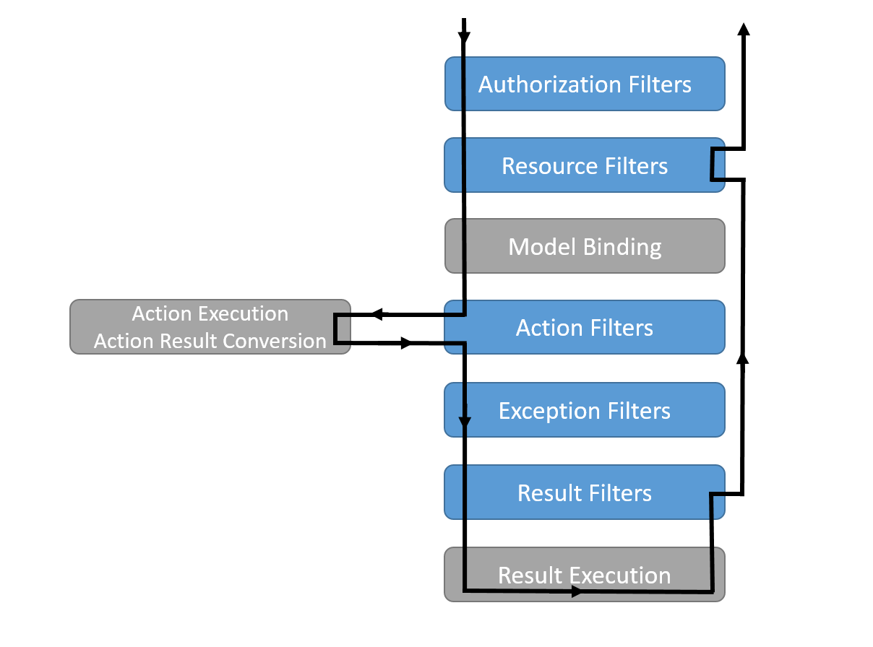
Filter Types
Filters in ASP.NET Core

Slide 6


Filter Types
Authorization filters: IAuthorizationFilter
Security policy including user authorization
Resource filters
Execute code before the rest of the pipeline
Typically used for caching / interrupting the request pipeline
Action filters: IActionFilter
Process logic before or after action method
Page filters are similar to action filters
Result filters: IResultFilter
Process logic before or after the result of action method
Exception filters: IExceptionFilter
Process unhandled exceptions

Slide 7
Context Data
Filters are provided with context data
ActionDescriptor – describes the action method
HttpContext – details of the HTTP request and response
ModelState – state of HTTP Request values including validation information
RouteData – the way that the routing system has processed the request
Filters – list of filters that have been applied to the action

Slide 8
Global Filters
Registering Global filters in the Startup.cs file
public void ConfigureServices(IServiceCollection
services)
{
services.AddMvc(options =>
{
options.Filters.Add(new GlobalFilterName());
options.Filters.Add(typeof(SimpleFilter));
});
}
An Instance
By Type

Slide 9

Custom Filters
Create Your Own Filters

Slide 10

Action Filter
Inherit from ActionFilterAttribute
We can override the following methods
OnActionExecuting(ActionExecutingContext)
OnActionExecuted(ActionExecutedContext)
OnResultExecuting(ResultExecutingContext)
OnResultExecuted(ResultExecutedContext)
public class LogAttribute : ActionFilterAttribute
{ … }

Slide 11
Result Filter
Inherit from ResultFilterAttribute
We can override the following methods
OnResultExecuting(ResultExecutingContext)
OnResultExecuted(ResultExecutedContext)
public class ResultDetailsAttribute :
ResultFilterAttribute
{ … }

Slide 12

Exception Filter
Inherit from ExceptionFilterAttribute
We can override the method
OnException(ExceptionContext)
ExceptionContext properties:
Exception – Exception that was thrown
ExceptionDispatchInfo – stack trace details
public class RangeExceptionAttribute :
ExceptionFilterAttribute
{ … }

Slide 13


Summary
Common filters
Filter types
Custom filters

Slide 14







ASP.NET Core Filters
https://softuni.bg/courses/asp-net-mvc

Slide 15
License
This course (slides, examples, demos, videos, homework, etc.) is licensed under the "Creative Commons Attribution-NonCommercial-ShareAlike 4.0 International" license

Slide 16





Trainings @ Software University (SoftUni)
Software University – High-Quality Education, Profession and Job for Software Developers
softuni.bg
Software University Foundation
http://softuni.foundation/
Software University @ Facebook
facebook.com/SoftwareUniversity
Software University Forums
forum.softuni.bg

